Slide 1
Student Performance Analysis Using Python
Presented by :
Moni Shree S

Slide 2
Problem Statement
Educational institutions need data-driven insights to better understand the factors affecting student academic performance. This project analyzes student demographic and academic data to identify key drivers of test scores and builds predictive models to estimate performance outcomes. The objective is to support early identification of at-risk students and provide actionable recommendations to improve academic success.

Slide 3
Dataset
Student-level academic & demographic data
Dataset Size: 205 student records with 16 features.
Data cleaned and prepared for modeling (missing values handled, rules enforced, encoding applied)
Target Variable: test_score
Key Features:
  Study hours per week
  Attendance rate
  Prior GPA (10-point scale)
  Internet access
  Gender
  Course stream

Slide 4
Data Handling & Cleaning
1. Missing Value Imputation
->Numeric columns → Median
->Categorical columns → Mode
2. Business Rule Enforcement
->If age < 17 → course stream cannot be "Degree"
3. Data Validation
->Invalid dates converted to NaT
->Duplicate records removed
->Data types corrected
4. Model Preparation
->Dropped irrelevant columns (student_id, comments)
->Boolean converted to 0/1
->Datetime columns removed before modeling

Slide 5
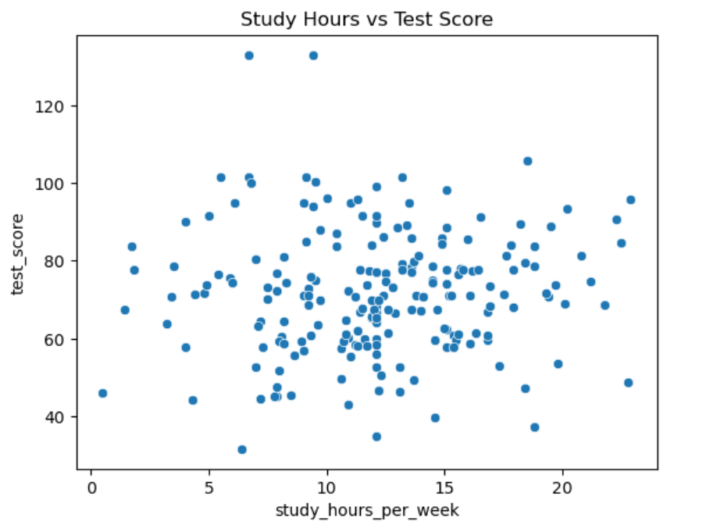
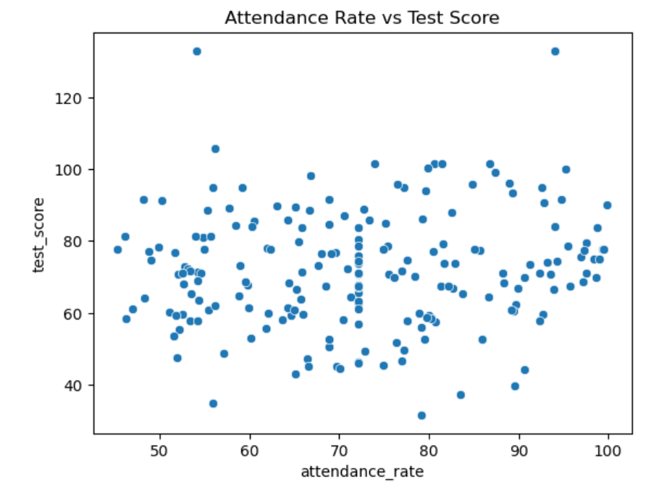
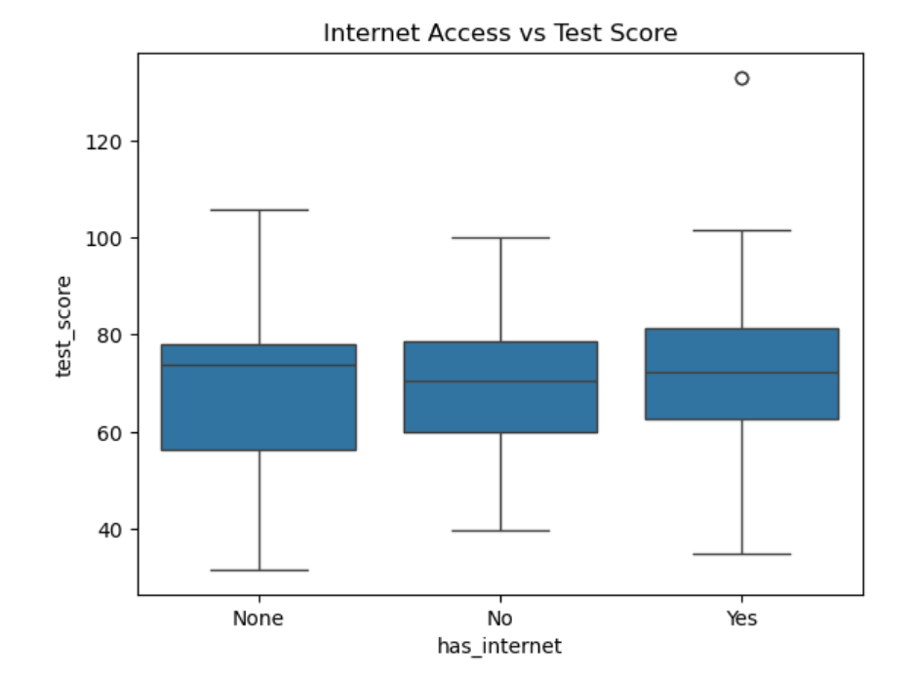
Exploratory Data Analysis (EDA)
Higher study hours → Higher test scores
Higher attendance → Better performance
Students with internet access perform better

Slide 6
Feature Engineering
Created new features:
  attendance_category (Low/Medium/High)
  gpa_band (Low/Medium/High)
  study_hours_bin
Applied One-Hot Encoding
Converted Boolean values to 0/1
Removed datetime fields
Scaled numeric features
These transformations improved model performance and interpretability.

Slide 7
Model Result
Model Performance (Test Data)
Model | RMSE | R² Score
Linear Regression | 0.915 | -0.198
Decision Tree | 1.124 | -0.806
Random Forest | 0.874 | -0.093

Slide 8
Thank You!

